Slide 1
OPER 618 Lesson 08 Extensive Form Games with Imperfect Information
Dr. Brian J. Lunday
Office: Rm 201E, Bldg 641

Slide 2
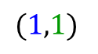
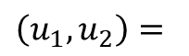
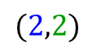
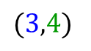
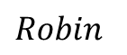
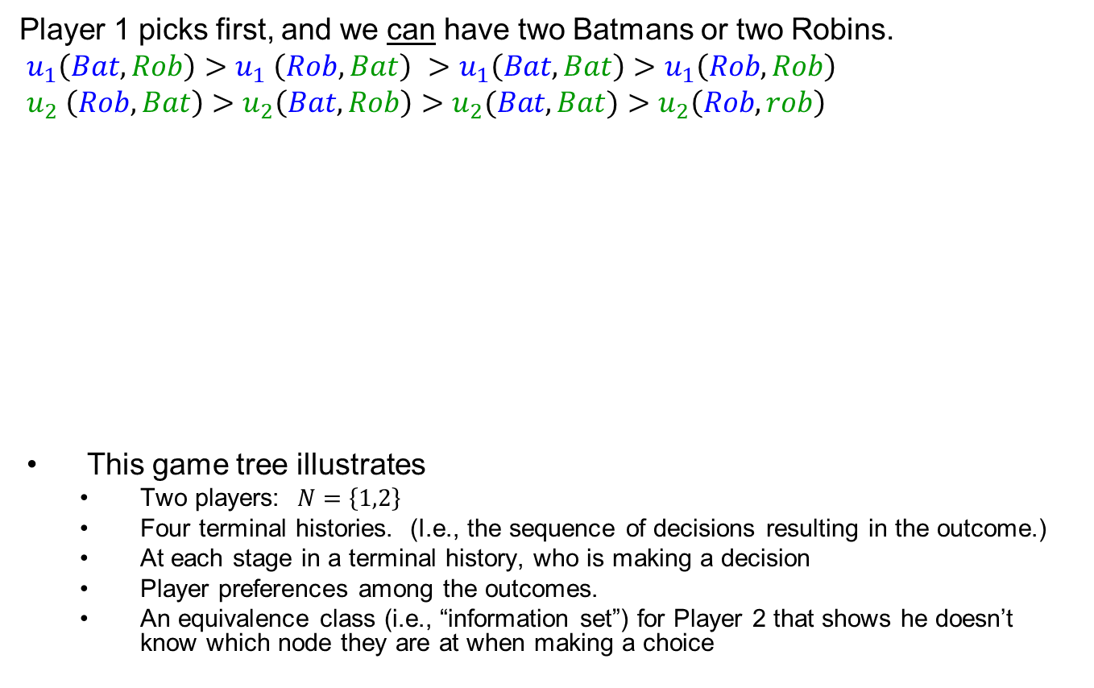
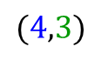
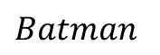
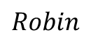
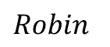
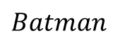
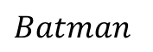
Halloween Costume Selection Tree Representation
Player 1 picks first, and we can have two Batmans or two Robins.
$$u_{1}\left(Bat,Rob\right)>u_{1} \left(Rob,Bat\right) >u_{1}\left(Bat,Bat\right)>u_{1}\left(Rob,Rob\right)$$
$$u_{2} \left(Rob,Bat\right)>u_{2}\left(Bat,Rob\right)>u_{2}(Bat,Bat)>u_{2}\left(Rob,rob\right)$$
This game tree illustrates
Two players: $N=\left\{1,2\right\}$
Four terminal histories. (I.e., the sequence of decisions resulting in the outcome.)
At each stage in a terminal history, who is making a decision
Player preferences among the outcomes.
An equivalence class (i.e., “information set”) for Player 2 that shows he doesn’t know which node they are at when making a choice
1
$$Batman$$
$$Robin$$
2
2
$$Batman$$
$$Robin$$
$$Batman$$
$$Robin$$
$$\left(u_{1},u_{2}\right)=$$
$$(2,2)$$
$$(4,3)$$
$$(3,4)$$
$$(1,1)$$

Slide 3
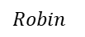
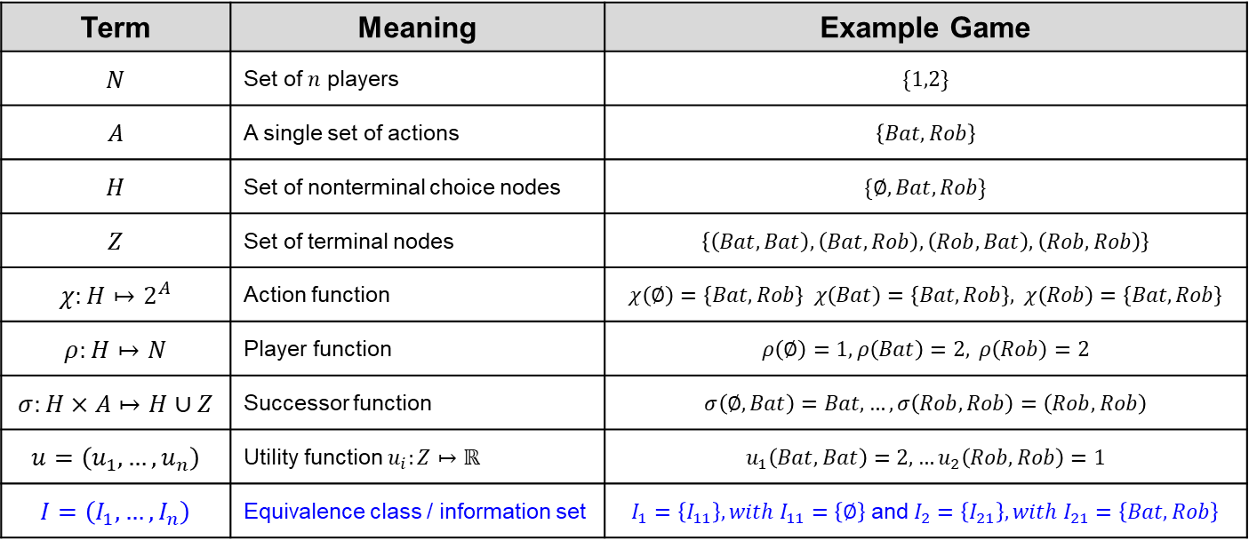
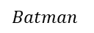

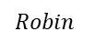
Defining the Game $$G=(N,A,H,Z,χ,ρ,σ, u,I)$$
1
$$Batman$$
$$Robin$$
2
2
$$Batman$$
$$Robin$$
$$Batman$$
$$Robin$$
$$(2,2)$$
$$(4,3)$$
$$(3,4)$$
$$(1,1)$$
Term | Meaning | Example Game
$$N$$ | Set of $n$ players | $$\{1,2\}$$
$$A$$ | A single set of actions | $$\left\{Bat,Rob\right\}$$
$$H$$ | Set of nonterminal choice nodes | $$\{∅,Bat, Rob\}$$
$$Z$$ | Set of terminal nodes | $$\left\{\left(Bat,Bat\right), \left(Bat,Rob\right), \left(Rob, Bat\right), \left(Rob,Rob\right)\right\}$$
$$χ:H↦2^{A}$$ | Action function | $$χ\left(∅\right)=\left\{Bat,Rob\right\} χ\left(Bat\right)=\left\{Bat,Rob\right\}, χ\left(Rob\right)=\left\{Bat,Rob\right\}$$
$$ρ:H↦N$$ | Player function | $$ρ\left(∅\right)=1, ρ\left(Bat\right)=2, ρ\left(Rob\right)=2$$
$$σ:H×A↦H∪Z$$ | Successor function | $$σ\left(∅,Bat\right)=Bat, …,σ\left(Rob,Rob\right)=\left(Rob,Rob\right)$$
$$u=\left(u_{1},…,u_{n}\right)$$ | Utility function $u_{i}:Z↦ℝ$ | $$u_{1}\left(Bat,Bat\right)=2,…u_{2}\left(Rob,Rob\right)=1$$
$$I=\left(I_{1},…,I_{n}\right)$$ | Equivalence class / information set | $I_{1}=\left\{I_{11}\right\}, with I_{11}=\left\{∅\right\}$ and $I_{2}=\left\{I_{21}\right\}, with I_{21}=\left\{Bat,Rob\right\}$

Slide 4
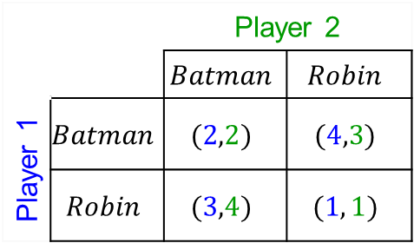
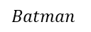
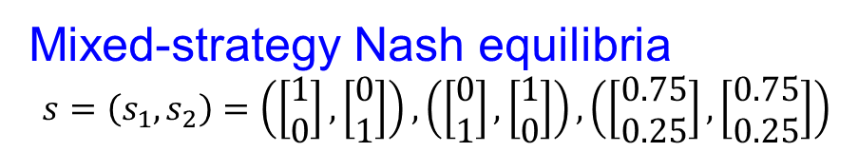
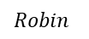
Are these Forms Equivalent?
NF Game
IIEF Game
1
 |  | Player 2
 |  | $$Batman$$ | $$Robin$$
Player 1 | $$Batman$$ | $$(2,2)$$ | $$(4,3)$$
 | $$Robin$$ | $$(3,4)$$ | $$(1, 1)$$
$$Batman$$
$$Robin$$
2
2
$$Batman$$
$$Robin$$
$$Batman$$
$$Robin$$
$$(2,2)$$
$$(4,3)$$
$$(3,4)$$
$$(1,1)$$
Mixed-strategy Nash equilibria
$$s=\left(s_{1},s_{2}\right)=\left(\left[\begin{aligned}1 \\ 0\end{aligned}\right],\left[\begin{aligned}0 \\ 1\end{aligned}\right]\right),\left(\left[\begin{aligned}0 \\ 1\end{aligned}\right],\left[\begin{aligned}1 \\ 0\end{aligned}\right]\right),\left(\left[\begin{aligned}0.75 \\ 0.25\end{aligned}\right],\left[\begin{aligned}0.75 \\ 0.25\end{aligned}\right]\right)$$
What else might we want to help prescribe strategies?

Slide 5
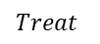
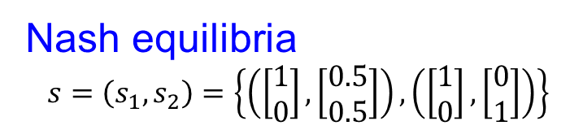
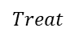
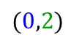
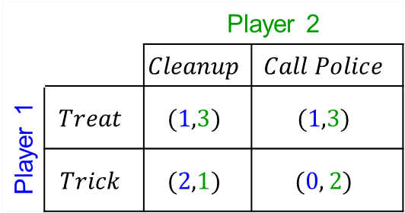
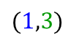
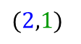
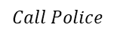
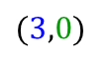
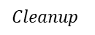
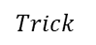
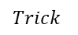
Mixed Strategies for EF Games Don’t Always Translate Well
NF Game
IIEF Game
1
 |  | Player 2
 |  | $$Cleanup$$ | $$Call Police$$
Player 1 | $$Treat$$ | $$(1,3)$$ | $$(1,3)$$
 | $$Trick$$ | $$(2,1)$$ | $$(0, 2)$$
$$Trick$$
$$Treat$$
1
2
$$Treat$$
$$Trick$$
$$Cleanup$$
$$Call Police$$
$$(1,3)$$
$$(3,0)$$
$$(2,1)$$
$$(0,2)$$
What would (should) P1 do?
Nash equilibria
$$s=\left(s_{1},s_{2}\right)=\left\{\left(\left[\begin{aligned}1 \\ 0\end{aligned}\right],\left[\begin{aligned}0.5 \\ 0.5\end{aligned}\right]\right),\left(\left[\begin{aligned}1 \\ 0\end{aligned}\right],\left[\begin{aligned}0 \\ 1\end{aligned}\right]\right)\right\}$$
Actually, there are an infinite number of NE consisting of the convex combination of the two indicated NE strategies for Player 2.

Slide 6
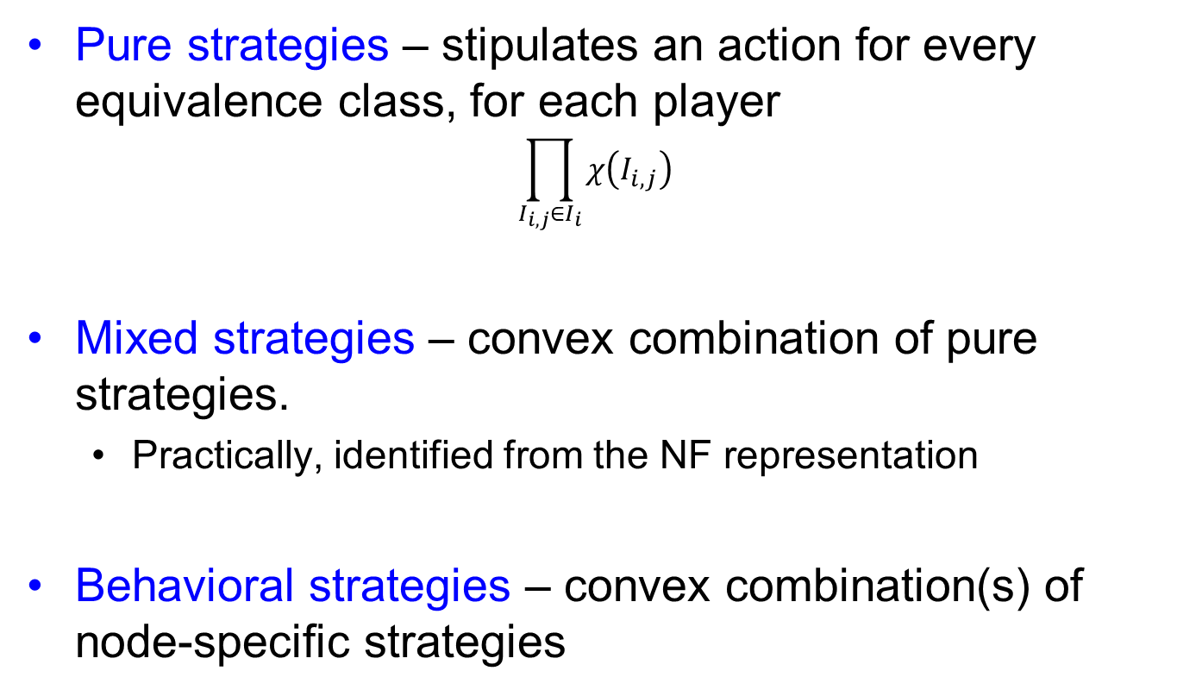
EF Game Strategies Pure, Mixed, & Behavioral
Pure strategies – stipulates an action for every equivalence class, for each player
$$\prod_{I_{i,j}∈I_{i}}{χ\left(I_{i,j}\right)}$$
Mixed strategies – convex combination of pure strategies.
Practically, identified from the NF representation
Behavioral strategies – convex combination(s) of node-specific strategies

Slide 7

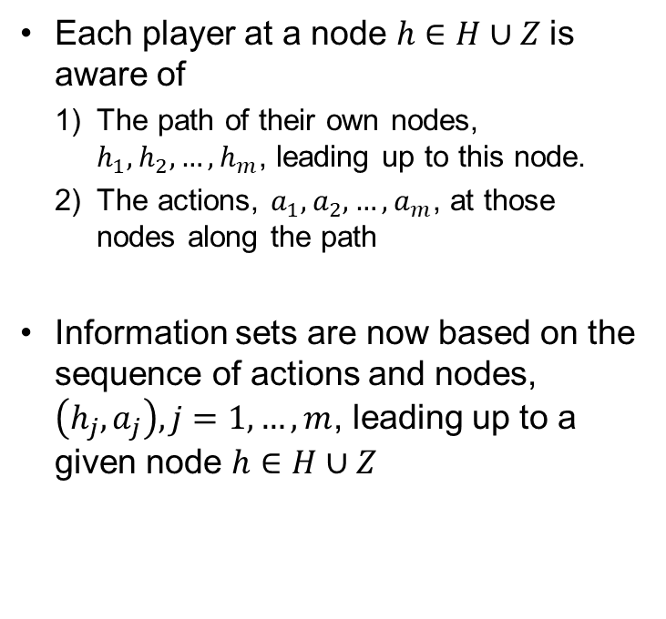
Perfect Recall An arguably reasonable IIEF assumption
Each player at a node $h∈H∪Z$is aware of
The path of their own nodes, $h_{1},h_{2},…,h_{m}$, leading up to this node.
The actions, $a_{1}, a_{2},…,a_{m}$, at those nodes along the path
Information sets are now based on the sequence of actions and nodes, $\left(h_{j},a_{j}\right), j=1,…,m$, leading up to a given node $h∈H∪Z$
Notes:
Each player does not necessarily know anything about the other players’ decisions
With perfect recall, a mixed strategy can be represented via a behavioral strategy and vice versa (Kuhn, 1953). Hereafter, we’ll use behavioral strategies.

Slide 8
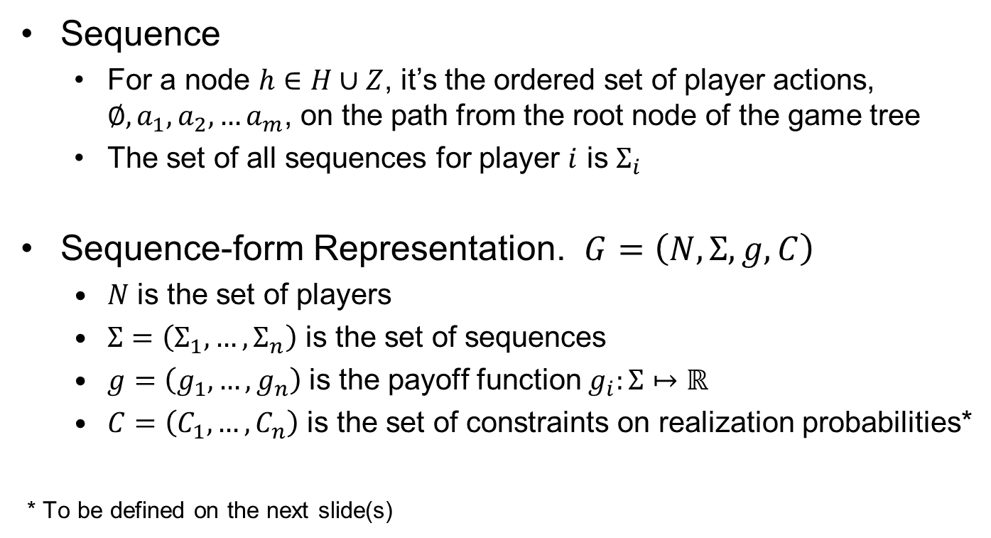
IIEF Games with Perfect Recall Sequence Form Representation
Sequence
For a node $h∈H∪Z$, it’s the ordered set of player actions, $∅, a_{1},a_{2},…a_{m}$, on the path from the root node of the game tree
The set of all sequences for player $i$ is $Σ_{i}$
Sequence-form Representation. $G=\left(N,Σ,g,C\right)$
$N$ is the set of players
$Σ=\left(Σ_{1},…,Σ_{n}\right)$ is the set of sequences
$g=\left(g_{1},…,g_{n}\right)$ is the payoff function $g_{i}:Σ↦ℝ$
$C=\left(C_{1},…,C_{n}\right)$ is the set of constraints on realization probabilities*
* To be defined on the next slide(s)

Slide 9
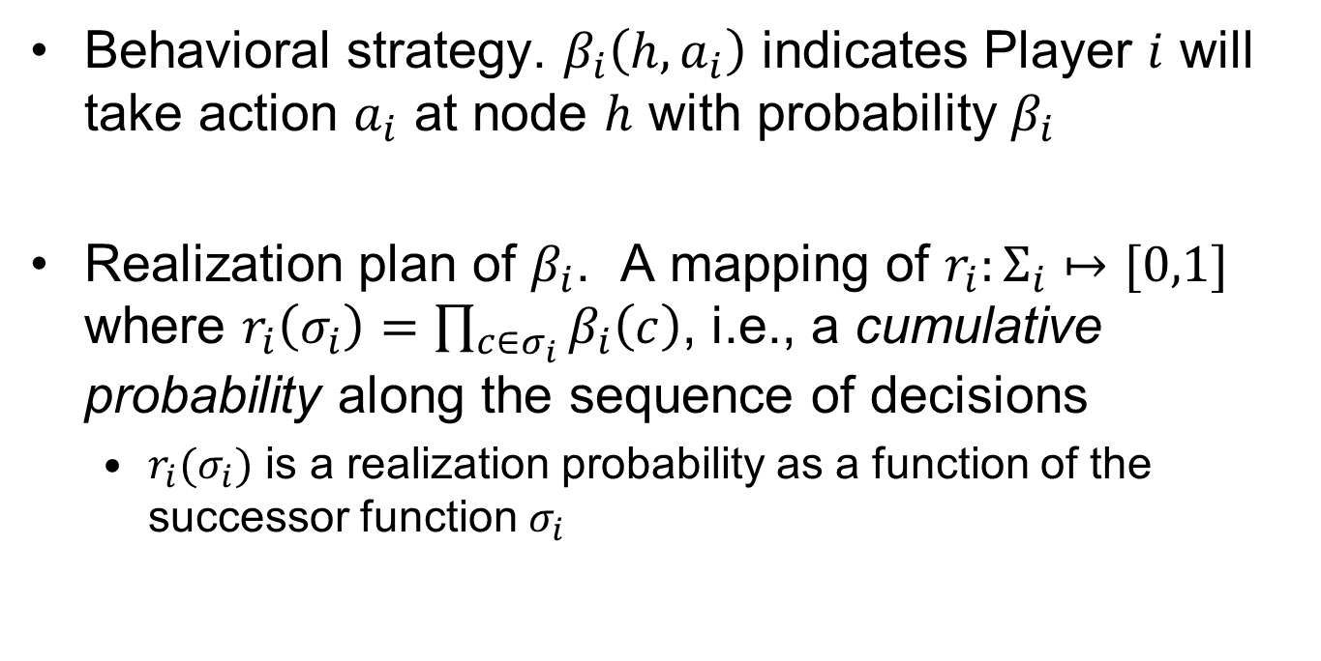
Behavioral Strategy via a Realization Plan
Behavioral strategy. $β_{i}\left(h,a_{i}\right)$ indicates Player $i$ will take action $a_{i}$ at node $h$ with probability $β_{i}$
Realization plan of $β_{i}$. A mapping of $r_{i}:Σ_{i}↦[0,1]$ where $r_{i}\left(σ_{i}\right)=\prod_{c∈σ_{i}}{β_{i}\left(c\right)}$, i.e., a cumulative probability along the sequence of decisions
$r_{i}(σ_{i})$ is a realization probability as a function of the successor function $σ_{i}$

Slide 10
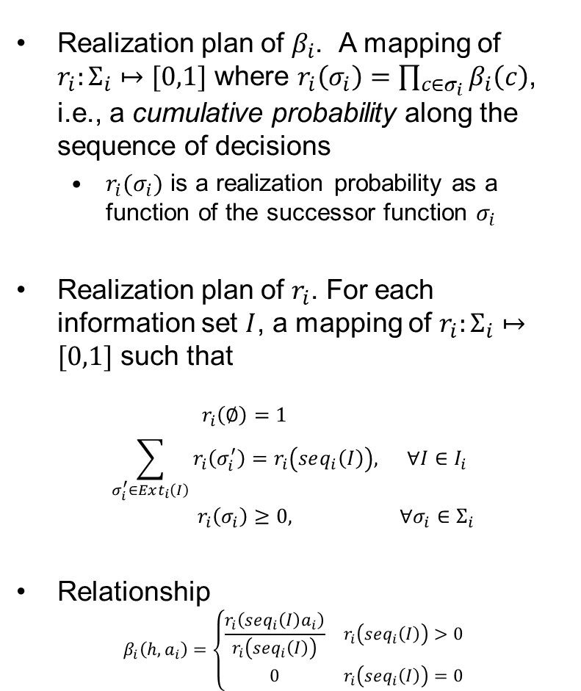
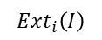
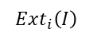
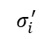
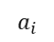
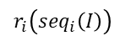
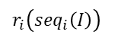
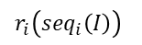
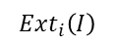
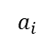
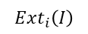
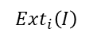
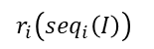
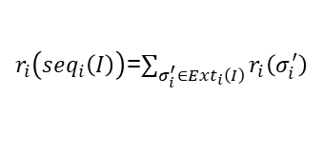



Alternative Representations of a Realization Plan
Realization plan of $β_{i}$. A mapping of $r_{i}:Σ_{i}↦[0,1]$ where $r_{i}\left(σ_{i}\right)=\prod_{c∈σ_{i}}{β_{i}\left(c\right)}$, i.e., a cumulative probability along the sequence of decisions
$r_{i}(σ_{i})$ is a realization probability as a function of the successor function $σ_{i}$
Realization plan of $r_{i}$. For each information set $I$, a mapping of $r_{i}:Σ_{i}↦[0,1]$ such that
$$\begin{matrix}r_{i}\left(∅\right)=1 & \\ \sum_{σ_{i}^{′}∈Ext_{i}\left(I\right)}{r_{i}\left(σ_{i}^{′}\right)}=r_{i}\left(seq_{i}\left(I\right)\right), & ∀I∈I_{i} \\ r_{i}\left(σ_{i}\right)≥0, & ∀σ_{i}∈Σ_{i}\end{matrix}$$
Relationship
$$β_{i}\left(h,a_{i}\right)=\left\{\begin{matrix}\frac{r_{i}\left(seq_{i}\left(I\right)a_{i}\right)}{r_{i}\left(seq_{i}\left(I\right)\right)} & r_{i}\left(seq_{i}\left(I\right)\right)>0 \\ 0 & r_{i}\left(seq_{i}\left(I\right)\right)=0\end{matrix}\right.$$
calculation paradigm
R
$$r_{i}\left(∅\right)=1$$
1
$r_{i}\left(seq_{i}\left(I\right)\right)$=$\sum_{σ_{i}^{′}∈Ext_{i}\left(I\right)}{r_{i}\left(σ_{i}^{′}\right)}$
$$a_{i}$$
$$a_{i}$$
$$a_{i}$$
$$σ_{i}^{′}$$
$$σ_{i}^{′}$$
$$σ_{i}^{′}$$
$$Ext_{i}\left(I\right)$$
1
$$r_{i}\left(seq_{i}\left(I\right)\right)$$
1
$$r_{i}\left(seq_{i}\left(I\right)\right)$$
$$a_{i}$$
$$a_{i}$$
$$a_{i}$$
$$a_{i}$$
$$a_{i}$$
$$a_{i}$$
$$σ_{i}^{′}$$
$$σ_{i}^{′}$$
$$σ_{i}^{′}$$
$$Ext_{i}\left(I\right)$$
$$σ_{i}^{′}$$
$$σ_{i}^{′}$$
$$σ_{i}^{′}$$
$$Ext_{i}\left(I\right)$$
1
$$r_{i}\left(seq_{i}\left(I\right)\right)$$
1
$$r_{i}\left(seq_{i}\left(I\right)\right)$$
$$a_{i}$$
$$a_{i}$$
$$a_{i}$$
$$a_{i}$$
$$a_{i}$$
$$a_{i}$$
$$σ_{i}^{′}$$
$$σ_{i}^{′}$$
$$σ_{i}^{′}$$
$$Ext_{i}\left(I\right)$$
$$σ_{i}^{′}$$
$$σ_{i}^{′}$$
$$σ_{i}^{′}$$
$$Ext_{i}\left(I\right)$$

Slide 11






















IIEF Games with Perfect Recall Best Responses for 2p Games
Primal: P1 maximizing utility, given P2 realization plan
calculation paradigm
R
$$r_{i}\left(∅\right)=1$$
$$\begin{matrix}max & \sum_{σ_{1}∈Σ_{1}}{\left(\sum_{σ_{2}∈Σ_{2}}{g_{1}\left(σ_{1},σ_{2}\right)r_{2}\left(σ_{2}\right)}\right)}r_{1}\left(σ_{1}\right) & & \left[dual vars.\right] \\ s.t. & r_{1}\left(∅\right)=1, & & \left[ν_{0}\right] \\ & r_{1}\left(seq_{1}\left(I\right)\right)−\sum_{σ_{1}^{′}∈Ext_{1}\left(I\right)}{r_{1}\left(σ_{1}^{′}\right)}=0, & ∀I∈I_{1} & \left[ν\right] \\ & r_{1}\left(σ_{1}\right)≥0, & ∀σ_{1}∈Σ_{1} & \end{matrix}$$
1
$r_{i}\left(seq_{i}\left(I\right)\right)$=$\sum_{σ_{i}^{′}∈Ext_{i}\left(I\right)}{r_{i}\left(σ_{i}^{′}\right)}$
$$a_{i}$$
$$a_{i}$$
$$a_{i}$$
$$σ_{i}^{′}$$
$$σ_{i}^{′}$$
$$σ_{i}^{′}$$
$$Ext_{i}\left(I\right)$$
Dual: P1 maximizing utility, given P2 realization plan
R
$$ν_{0}$$
calculation paradigm
$$\begin{matrix}min & ν_{0} & \\ s.t. & ν_{ℐ_{1}\left(σ_{1}\right)}−\sum_{I^{′}∈ℐ_{1}\left(Ext_{1}\left(σ_{1}\right)\right)}{ν_{I^{′}}}≥\sum_{σ_{2}∈Σ_{2}}{g_{1}\left(σ_{1},σ_{2}\right)r_{2}\left(σ_{2}\right)}, & ∀σ_{1}∈Σ_{1}\end{matrix}$$
1
$$ν_{I_{i}\left(σ_{1}\right)}$$
$$ν_{I^{′}}$$
$$ν_{I^{′}}$$
$$ν_{I^{′}}$$
1
$$ν_{I_{i}\left(σ_{1}\right)}$$
Notes:
Player 1’s expected utility is $ν_{0}$, the label of the root note
Player 1’s expected utility accumulated from the subgame starting at $I$ is $ν_{I}$, the label of the node at $I$ (or equivalently $ℐ_{1}\left(σ_{1}\right)$)
If $r_{1}\left(σ_{1}\right)$>0 at optimality, dual constraint is tight. (If dual constraint is not tight at optimality, $r_{1}\left(σ_{1}\right)$=0.)
$$Ext_{i}\left(I\right)$$
1
$$ν_{I_{i}\left(σ_{1}\right)}$$
$$ν_{I^{′}}$$
$$ν_{I^{′}}$$
$$g_{1}\left(σ_{1},σ_{2}\right)r_{2}\left(σ_{2}\right)$$
$$Ext_{i}\left(I\right)$$
$$g_{1}\left(σ_{1},σ_{2}\right)r_{2}\left(σ_{2}\right)$$
$$g_{1}\left(σ_{1},σ_{2}\right)r_{2}\left(σ_{2}\right)$$

Slide 12












Nash Eq. for IIEF w/Perfect Recall Two-player Zero-sum Games
P1 maximizing utility (by minimizing the dual), given a P2 realization plan
$$\begin{matrix}min & ν_{0} & \\ s.t. & ν_{ℐ_{1}\left(σ_{1}\right)}−\sum_{I^{′}∈ℐ_{1}\left(Ext_{1}\left(σ_{1}\right)\right)}{ν_{I^{′}}}≥\sum_{σ_{2}∈Σ_{2}}{g_{1}\left(σ_{1},σ_{2}\right)r_{2}\left(σ_{2}\right)}, & ∀σ_{1}∈Σ_{1}\end{matrix}$$
R
$$ν_{0}$$
calculation paradigm
1
$$ν_{I_{i}\left(σ_{1}\right)}$$
$$ν_{I^{′}}$$
$$ν_{I^{′}}$$
$$ν_{I^{′}}$$
P2 minimizing the maximum utility for P1
$$Ext_{i}\left(I\right)$$
$$\begin{matrix}min & ν_{0} & \\ s.t. & ν_{ℐ_{1}\left(σ_{1}\right)}−\sum_{I^{′}∈ℐ_{1}\left(Ext_{1}\left(σ_{1}\right)\right)}{ν_{I^{′}}}≥\sum_{σ_{2}∈Σ_{2}}{g_{1}\left(σ_{1},σ_{2}\right)r_{2}\left(σ_{2}\right)}, & ∀σ_{1}∈Σ_{1} \\ & r_{2}\left(∅\right)=1, & \\ & r_{2}\left(seq_{2}\left(I\right)\right)−\sum_{σ_{2}^{′}∈Ext_{2}\left(I\right)}{r_{2}\left(σ_{2}^{′}\right)}=0, & ∀I∈I_{2} \\ & r_{2}\left(σ_{2}\right)≥0, & ∀σ_{2}∈Σ_{2}\end{matrix}$$
1
$$ν_{I_{i}\left(σ_{1}\right)}$$
$$ν_{I^{′}}$$
$$ν_{I^{′}}$$
$$g_{1}\left(σ_{1},σ_{2}\right)r_{2}\left(σ_{2}\right)$$
$$Ext_{i}\left(I\right)$$
1
$$ν_{I_{i}\left(σ_{1}\right)}$$
$$g_{1}\left(σ_{1},σ_{2}\right)r_{2}\left(σ_{2}\right)$$
$$g_{1}\left(σ_{1},σ_{2}\right)r_{2}\left(σ_{2}\right)$$

Slide 13





Nash Eq. for IIEF w/Perfect Recall Two-player General-sum Games
P1 realization plan
P2 realization plan
$$\begin{matrix}r_{1}\left(∅\right)=1, & \\ \sum_{σ_{1}^{′}∈Ext_{1}\left(I\right)}{r_{1}\left(σ_{1}^{′}\right)}=r_{1}\left(seq_{1}\left(I\right)\right), & ∀I∈I_{1} \\ r_{1}\left(σ_{1}\right)≥0, & ∀σ_{1}∈Σ_{1}\end{matrix}$$
$$\begin{matrix}r_{2}\left(∅\right)=1, & \\ \sum_{σ_{2}^{′}∈Ext_{2}\left(I\right)}{r_{2}\left(σ_{2}^{′}\right)}=r_{2}\left(seq_{2}\left(I\right)\right), & ∀I∈I_{2} \\ r_{2}\left(σ_{2}\right)≥0, & ∀σ_{2}∈Σ_{2}\end{matrix}$$
P1 utility bounds
P2 utility bounds
$$\begin{matrix}ν_{ℐ_{1}\left(σ_{1}\right)}^{1}−\sum_{I^{′}∈ℐ_{1}\left(Ext_{1}\left(σ_{1}\right)\right)}{ν_{I^{′}}^{1}}≥\sum_{σ_{2}∈Σ_{2}}{g_{1}\left(σ_{1},σ_{2}\right)r_{2}\left(σ_{2}\right)}, & ∀σ_{1}∈Σ_{1}\end{matrix}$$
$$\begin{matrix}ν_{ℐ_{2}\left(σ_{2}\right)}^{2}−\sum_{I^{′}∈ℐ_{2}\left(Ext_{2}\left(σ_{2}\right)\right)}{ν_{I^{′}}^{2}}≥\sum_{σ_{1}∈Σ_{1}}{g_{2}\left(σ_{1},σ_{2}\right)r_{1}\left(σ_{1}\right)}, & ∀σ_{2}∈Σ_{2}\end{matrix}$$
Complementary Slackness Conditions
$$\begin{matrix}r_{1}\left(σ_{1}\right)\left[ν_{ℐ_{1}\left(σ_{1}\right)}^{1}−\sum_{I^{′}∈ℐ_{1}\left(Ext_{1}\left(σ_{1}\right)\right)}{ν_{I^{′}}^{1}}−\sum_{σ_{2}∈Σ_{2}}{g_{1}\left(σ_{1},σ_{2}\right)r_{2}\left(σ_{2}\right)}\right]=0, & ∀σ_{1}∈Σ_{1}\end{matrix}$$
$$r_{2}\left(σ_{2}\right)\left[ν_{ℐ_{2}\left(σ_{2}\right)}^{2}−\sum_{I^{′}∈ℐ_{2}\left(Ext_{2}\left(σ_{2}\right)\right)}{ν_{I^{′}}^{2}}−\sum_{σ_{1}∈Σ_{1}}{g_{2}\left(σ_{1},σ_{2}\right)r_{1}\left(σ_{1}\right)}\right]\begin{matrix}=0, & ∀σ_{2}∈Σ_{2}\end{matrix}$$
See Note (3) from two slides ago
How would you classify this formulation?
Would transformations be helpful? If so, how?
What commercial solvers can we use to solve it?

Slide 14

Sequential Equilibrium for IIEF Games with Perfect Recall
A sequential equilibrium $s$ for a game $G$ has probability distributions $μ(h)$ for each information set $h$* such that
We have $\left(s,μ\right)=\lim_{m→∞}\left(s^{m},μ^{m}\right)$ for a sequence $\left(s^{1},μ^{1}\right), \left(s^{2},μ^{2}\right),…$ where $s^{m}$ is fully mixed and $μ^{m}$ is consistent
The following condition holds
$$u_{i}\left(s | h,μ\left(h\right)\right)≥u_{i}\left(\left(s_{i}^{′},s_{−i}\right)|h,μ\left(h\right)\right), ∀s_{i}^{′}∈S_{i}, i∈N$$
SE always exist
* Note the implied equivalence between a non-terminal node $h$ and an information set $I$ for a perfect recall game

Slide 15







SE Example - IIEF Game w/P.R. (1 of 3)
1
L
$$\text{R}$$
2
The IIEF Game
L
R
a
b
3
3
$$(1,1,1)$$
L
R
L
R
$$(0,0,0)$$
$$(3,2,2)$$
$$(0,0,1)$$
$$(4,4,0)$$
Player | $$s$$ | $$μ(h)$$
1 | $$\left(s_{L},s_{R}\right)=\left(ε,1−ε\right)$$ | -
2 | $$\left(s_{L},s_{R}\right)=\left(η,1−η\right)$$ | -
3 | $$\left(s_{L},s_{R}\right)=\left(δ,1−δ\right)$$ | $$\left(μ\left(a\right),μ\left(b\right)\right)=\left(π,1−π\right)$$
A Sequential Equilibrium

Slide 16




















SE Example - IIEF Game w/P.R. (2 of 3)
Player 1 Utility and Best Response
1
$u_{1}\left(L\right)=3(1−δ)$
$u_{1}\left(R\right)=\left(1−η\right)+η4(1−δ)$
$ε=\left\{\begin{matrix}1 & 2−3δ>\left(3−4δ\right)η \\ \left[0,1\right] & 2−3δ=\left(3−4δ\right)η \\ 0 & 2−3δ<\left(3−4δ\right)η\end{matrix}\right.$
$$ε$$
$$1−ε$$
2
$$η$$
$$1−η$$
$$π$$
$$1−π$$
3
3
$$(1,1,1)$$
Player 2 Utility and Best Response
$$δ$$
$$1−δ$$
$$δ$$
$$1−δ$$
$u_{2}\left(L\right)=4(1−δ)$
$u_{2}\left(R\right)=1$
$η=\left\{\begin{matrix}1 & δ<3/4 \\ \left[0,1\right] & δ=3/4 \\ 0 & δ>3/4\end{matrix}\right.$
$$(0,0,0)$$
$$(3,2,2)$$
$$(0,0,1)$$
$$(4,4,0)$$
Player 3 Utility and Best Response
Player 3 beliefs must be consistent
(at the limit of a sequence $\left(s^{k},μ^{k}\left(h\right)\right)$)
$u_{3}\left(L\right)=(1−π)$
$u_{3}\left(R\right)=2π$
$δ=\left\{\begin{matrix}1 & π<1/3 \\ \left[0,1\right] & π=1/3 \\ 0 & π>1/3\end{matrix}\right.$
$π=⁡\frac{ε}{ε+η(1−ε)}$

Slide 17




















SE Example - IIEF Game w/P.R. (3 of 3)
Best Responses & Consistency
Analysis
(select a parameter and condition on it)
$ε=\left\{\begin{matrix}1 & 2−3δ>\left(3−4δ\right)η \\ \left[0,1\right] & 2−3δ=\left(3−4δ\right)η \\ 0 & 2−3δ<\left(3−4δ\right)η\end{matrix}\right.$
Case 1: $η=1$
Then $δ≤3/4$
So $ε=0$ because $2−3δ<\left(3−4δ\right)$ or $δ<1$
And $π≥1/3$ because $δ≤3/4$
Thus, we need $\frac{ε}{ε+η(1−ε)}≥1/3$ or $ε≥\frac{η}{2+η}$, which we do not have.
→ No SE results
Case 2: $0<η<1$
Then $δ=3/4$
So $ε=0$ because $2−3(3/4)<0$
And $π=1/3$ because $δ=3/4$
Thus, we need $\frac{ε}{ε+η(1−ε)}=1/3$ or $ε=\frac{η}{2+η}$, which we do not have.
→ No SE results
Case 3: $η=0$
Then $δ≥3/4$
So $ε=0$ because $2−3(3/4)<0$
And $π≤1/3$ because $δ≥3/4$
Thus, we need $\frac{ε}{ε+η(1−ε)}≤1/3$ or $ε≤\frac{η}{2+η}$, which we can have.
→ $\left(ε,η,δ,π\right)=\left\{\left(0,0,δ,π\right) | δ∈\left[3/4,1\right],π∈\left[0,1/3\right]\right\}$
$η=\left\{\begin{matrix}1 & δ<3/4 \\ \left[0,1\right] & δ=3/4 \\ 0 & δ>3/4\end{matrix}\right.$
$δ=\left\{\begin{matrix}1 & π<1/3 \\ \left[0,1\right] & π=1/3 \\ 0 & π>1/3\end{matrix}\right.$
$π=\frac{ε}{ε+η(1−ε)}$ (at a limit)
1
$$ε$$
$$1−ε$$
2
$$η$$
$$1−η$$
$$π$$
$$1−π$$
3
3
$$(1,1,1)$$
$$δ$$
$$1−δ$$
$$δ$$
$$1−δ$$
What does this SE mean, vis-à-vis the IIEF game?
$$(0,0,0)$$
$$(3,2,2)$$
$$(0,0,1)$$
$$(4,4,0)$$

Slide 18
Questions & Discussion

